Slide 1

Multimedia
by Aashish Subedi

Slide 2
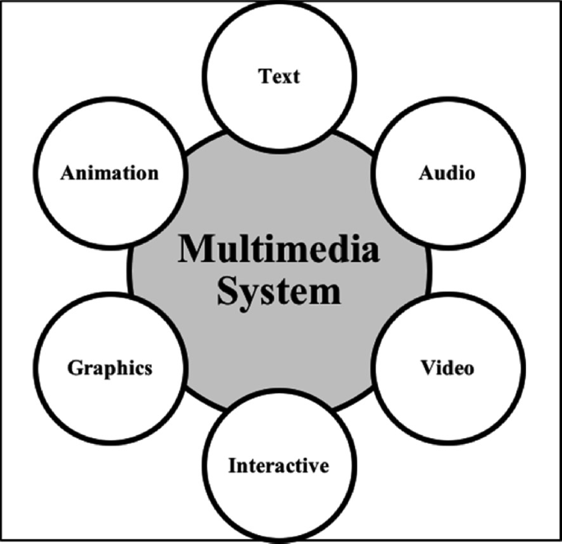
Introduction about Multimedia
Multimedia is the combination of text, images, audio, video, graphics, and animation to present information in an engaging and interactive way. It is widely used in education, entertainment, business, and communication to make content more effective and appealing.
Fig: Multimedia

Slide 3
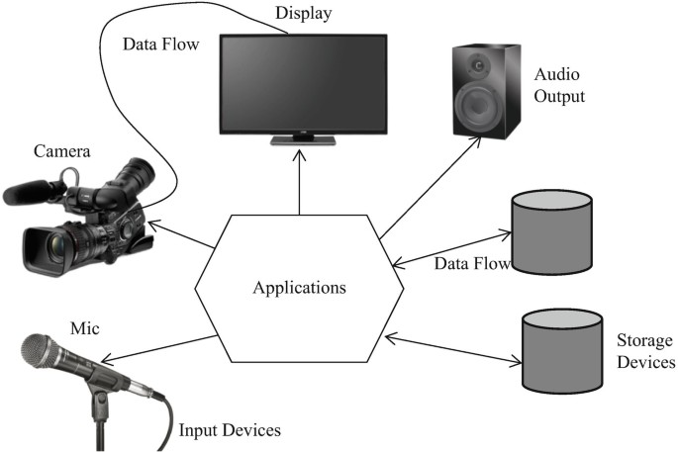
Applications of Multimedia
Education:
e-learning, online courses,interactive tutorials.
Entertainment
movies, video games, music, animations.
Business
advertisements, product presentations, training programs.
Communication
video conferencing, social media, digital storytelling.
Healthcare
medical training, patient education, simulations.
Science & Research – data visualization, simulations, virtual labs.
Fig: Application of Multimedia

Slide 4

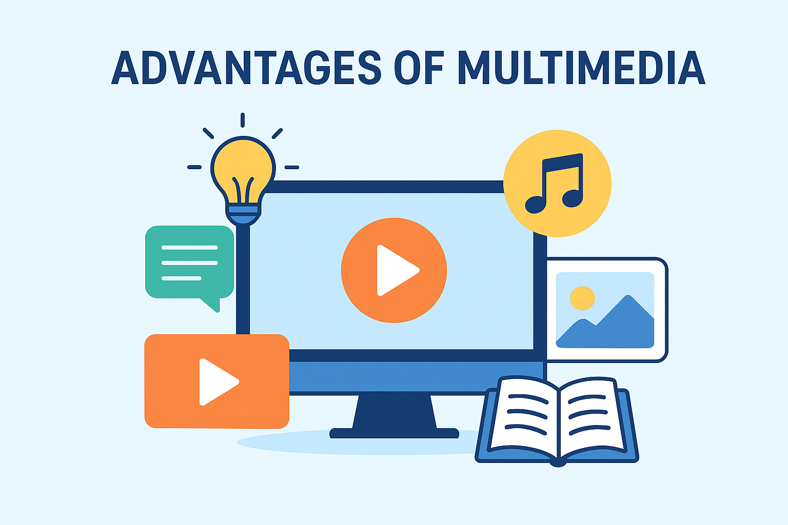
Advantages of Multimedia
Makes learning and communication more engaging.
Combines text, audio, video, and graphics for better
understanding.
Increases attention and interest of users.
Useful in education, business, entertainment, and healthcare.
Provides interactive and creative ways to present information.

Slide 5
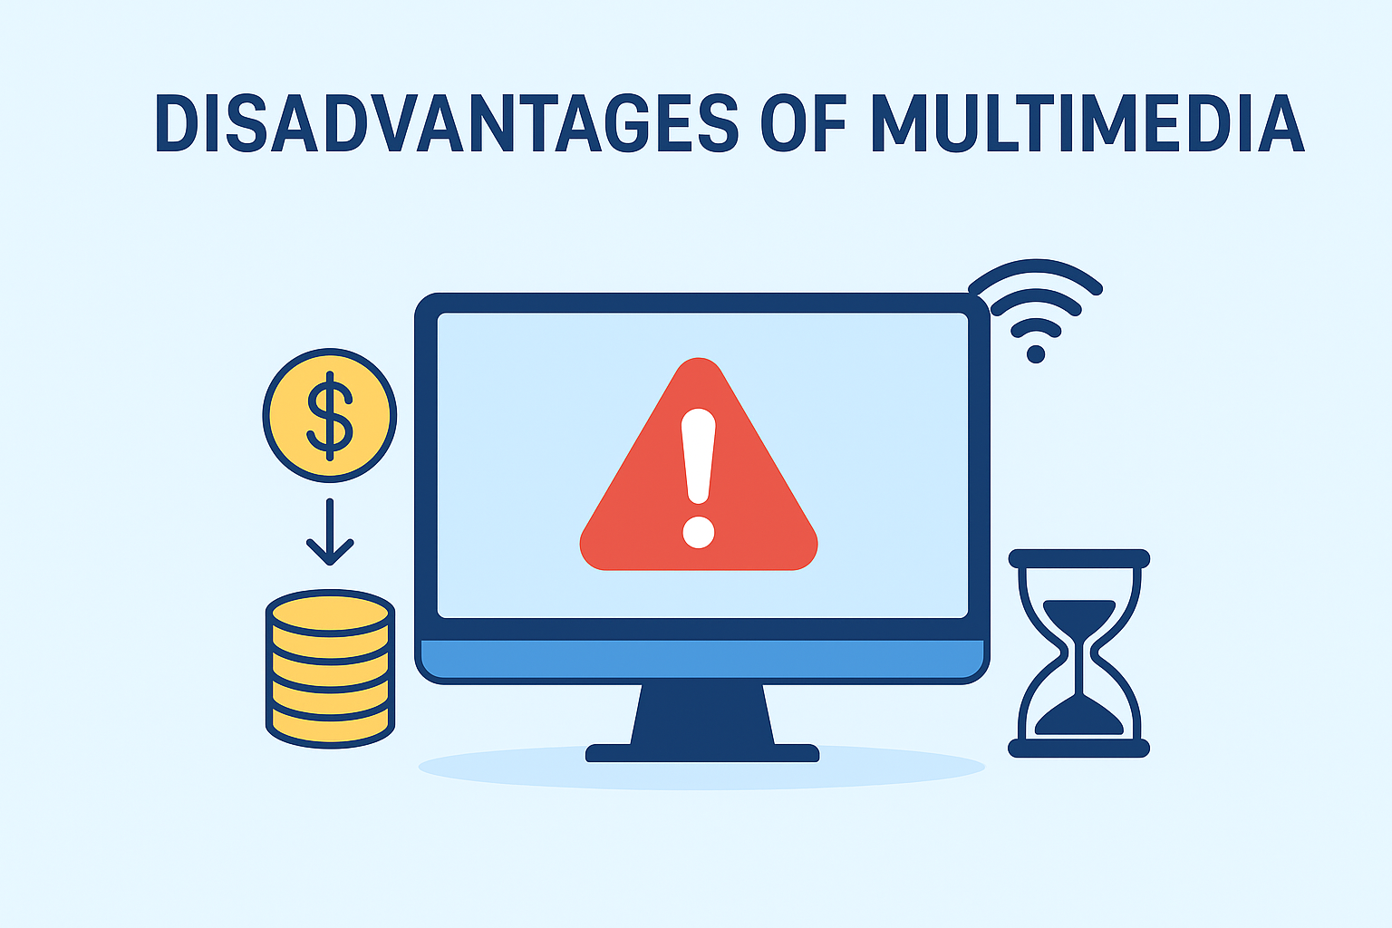
Disadvantages of Multimedia
Can be expensive to create and maintain.
Requires more storage space and high-speed internet.
May distract users if overused.
Needs technical skills to design and develop.
Not always accessible to people without proper devices or connectivity.

Slide 6
Thank You

